Slide 1
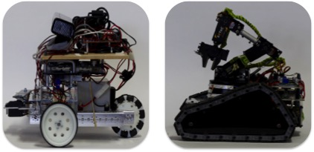
Subsystem- DaNI bot

Slide 2
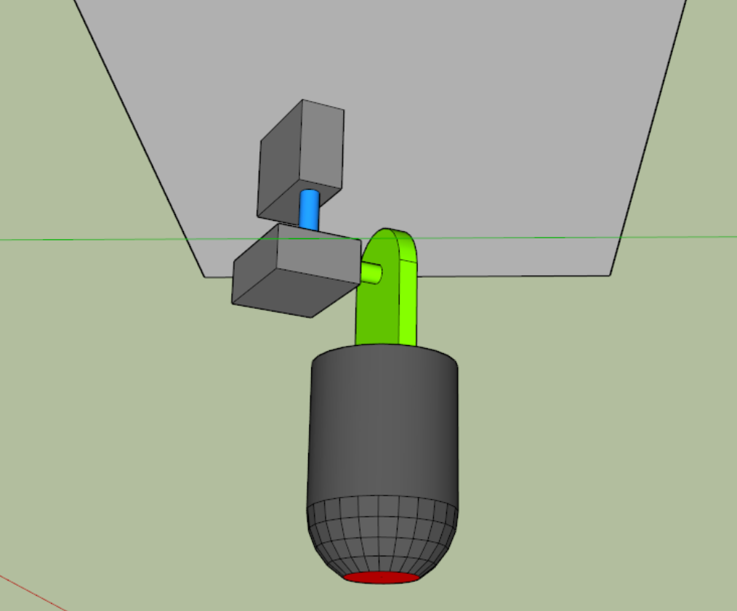
Laser guidance system
Can be used as a tool to help the DaNI bot navigate
Alternative use can be to check the location of the DaNI bot for accuracy
Works by having the laser system mounted on the ceiling pointing at a number of LDRs placed on the DaNI bot
Depending what LDR is hit by the laser depends on how the DaNI bot will move
Motor 1
Motor 2

Slide 3
Laser guidance system-laser pointer
Motor 1 is used to control the direction its facing
Motor 2 is used to control the angle of the laser
Using trigonometry the distance and angle the laser has travelled can be determined and therefore the location of the DaNI
Motor 1 angle
Motor 2 Angle
Known height

Slide 4
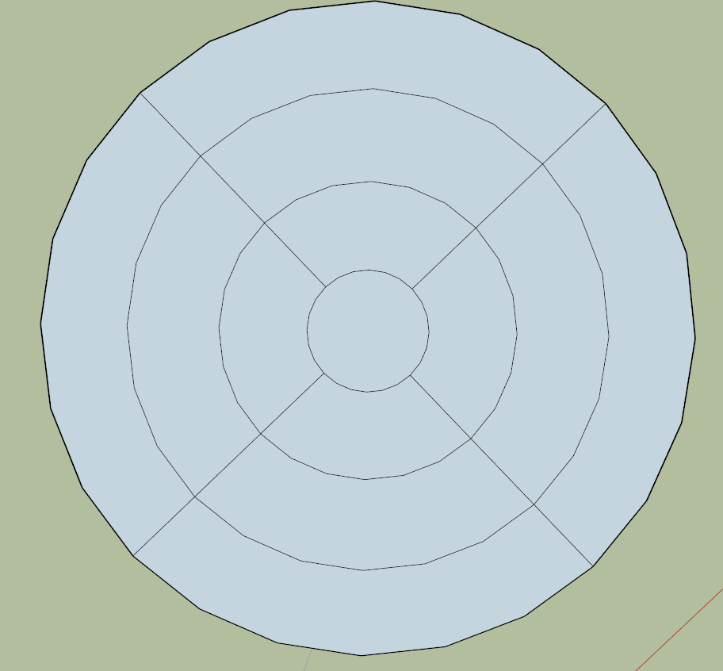
Laser Guidance System-Navigation system
Laser starts by pointing at the section C
If the laser moves into the section N1 the DaNI bot will move forward to re-centre the laser back to C
If the laser moves to the section E1 it will move right to re-centre
If the laser is in section N2 it will move quicker to re-center
N3
N2
N1
C
E1
E2
E3

Slide 5
Laser guidance system - location system
This system will be made up of the same hardware as before
The DaNI bot will use a system like the Kinect to decide where to navigate and the laser will be used to check if it has moved to the correct location
For example if the DaNI bot moves to locate 10,9 the laser will point in that coordinate
If the DaNI does not detect the laser it will know that it has moved to an incorrect location and the laser can determine where it is.

Slide 6
Now for a quick demonstration

Slide 7
Subsystem – Tri Track

Slide 8
Now for a quick demonstration

Slide 9
Tri Track Bot Board
Programmed the system to move with the use of keys
- ‘w’: Forward movement - ‘a’: Left turn - ‘s’: Backward Movement - ‘d’: Right Turn - ‘0’: Stop
Lags slightly between instruction and execution.

Slide 10
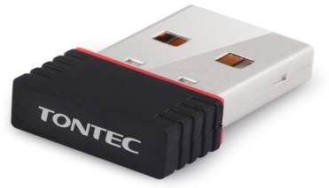
Raspberry Pi
Decided to use Pi over the current bot board on the Tri Track.
Gives us 4 USB connections to allow uses for webcam, wireless dongle, etc.
Allows data (i.e. Coding) to be stored on the pi (via micros SD, USB drive)
Pi has better capability to run many things at one time.
Needs a servo shield.

Slide 11
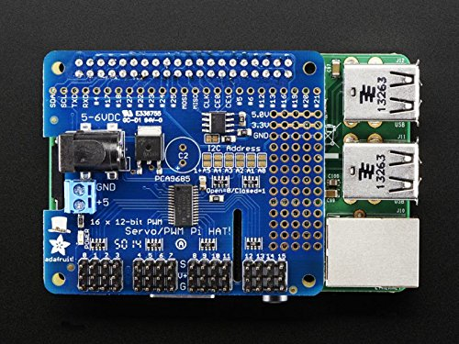
Servo Shield
As Tri Track servos work on 3 pin system; Pi only has 2 pin input.
Servo shield allows 3 pins to be inputted into Pi.
Raspberry Pi
Servo Shield

